Slide 1
Presentation
22.02.2025

Slide 2

Content of the CAMARA presentation
#3 CAMARA Mission
#4-#7 CAMARA Motivation – Key problems we try to solve
#8-#14 CAMARA Scope, Collaboration with Open Gateway and TM Forum, API Distribution Options
#15 What is different now in comparison to former API exposure trials?
#16-#18 History, Logos & Current Figures – Where we started and where we are now
#19-#27 Current Meta Release, CAMARA APIs, Showcases, Public Launch Status
#29-#31 5G network capabilities, Potential Business Use Cases
#32-#35 Benefit for developers to use CAMARA APIs & Getting Started
#36-#40 Benefit for developers to work in CAMARA & Joining CAMARA as Developer
#41-#43 Benefit for operators to implement CAMARA APIs in their networks & Getting Started
#44-#46 Benefit for operators to work in CAMARA & Getting Started
#47-#48 Where are we going next, Contacts

Slide 3
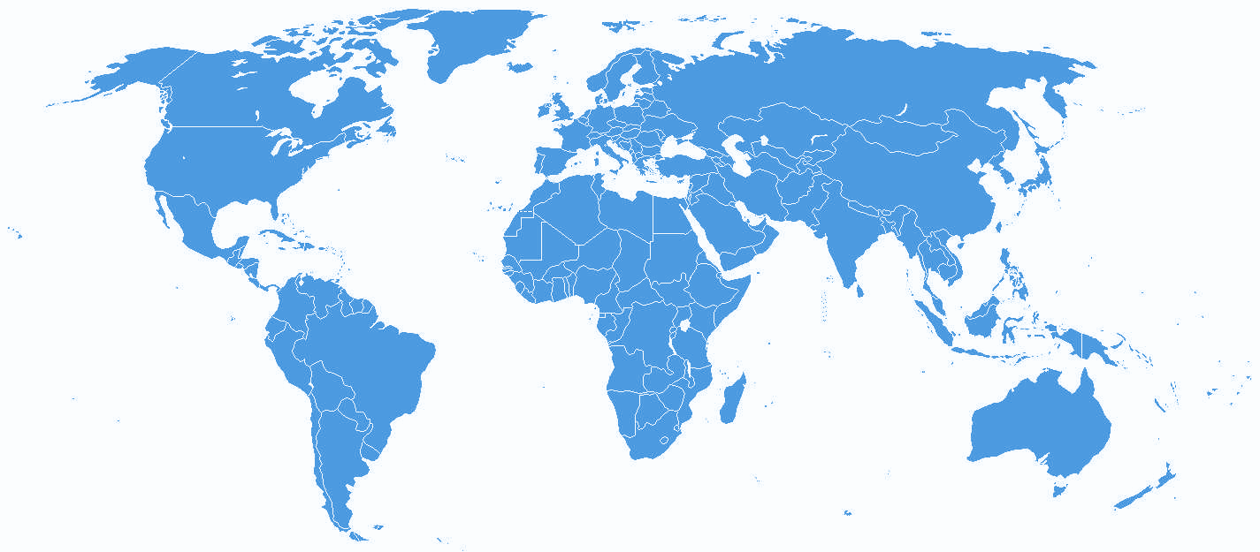

APIs enabling seamless access to Telco network capabilities
Telco network capabilities exposed through APIs provide a large benefit for customers. By simplifying telco network complexity with APIs and making the APIs available across telco networks and countries, CAMARA enables easy and seamless access.
CAMARA Mission

Slide 4





What is the CAMARA Project? Key problems we try to solve
Scale
Developers dream of being the next unicorn… If apps, products, or services are built on our APIs they want them in all relevant markets and networks globally.
Consistency
Multi-nationals want consistency across all markets they operate in… they do not want APIs that only work in a single network in a single country. They do not want to try and build for the differences of each network.
Simplicity
Telco networks are complex, and every network is different…. Developers want simple, intent-based APIs.
Accessibility
We go to the developers where they are so the project is open sourced in the Linux Foundation. Allowing API users to work directly with CSPs creating the service.
Demand Driven
We develop the APIs and design it in the way our customers need it. The demand is collected from organizations like GSMA OPAG but also from customers directly.

Slide 5
Key problems we try to solve Consistency Benefit
Availability across telco networks and countries is necessary:
To ensure seamless customer experience
To accelerate technology development and commercial adoption (minimize implementation effort)
To accelerate education and promotion
To support application portability

Slide 6
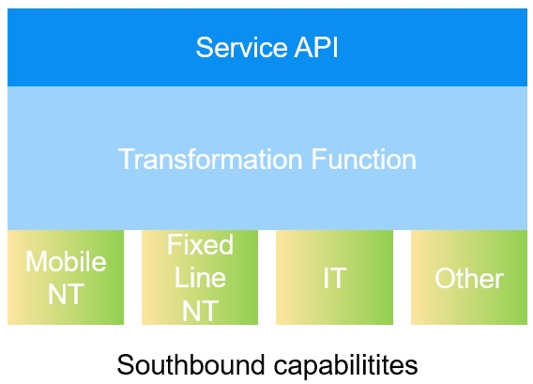
Key problems we try to solve Simplicity Benefit
Abstraction from Network APIs to Service APIs is necessary:
To simplify telco complexity making APIs easy to consume for customers with no telco expertise (user-friendly APIs)
To satisfy data privacy and regulatory requirements
To facilitate application to network integration

Slide 7


CAMARA Open Source
CAMARA is an open source project within Linux Foundation to define, develop and test the APIs. CAMARA works in close collaboration with the GSMA Operator Platform Group to align API requirements and publish API definitions and APIs. Harmonization of APIs is achieved through fast and agile created working code with developer-friendly documentation. API definitions and reference implementations are free to use (Apache2.0 license).

Slide 8



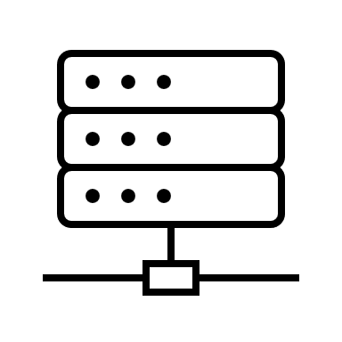
CAMARA Scope
Application
From functional perspective the scope is limited to telco APIs, that means APIs in the domain of telco mobile networks, telco fixed line networks, telco edge cloud, etc. or supporting these.
Thereby the focus is on the northbound interface (between telco operator and aggregator or capability consumer). East-/westbound interface APIs are out of scope for CAMARA.
N
Service API
Exposure Gateway
E/W
Transformation Function
S
Network API
S
NT/IT/Other
Operator 1
Operator 2

Slide 9
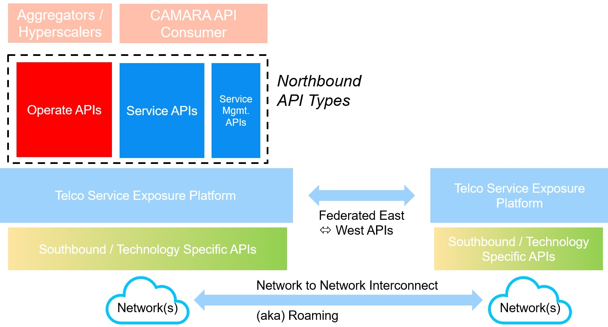
CAMARA Scope
We differentiate between 3 types of Northbound APIs:
Service APIs: APIs intended for end consumers and integrated by developers to invoke a certain telco capability.
Service Management APIs: APIs intended for end consumers to manage or get data about offered Service APIs in application runtime, e.g., check service availability or performance information.
Operate APIs: Operational and maintenance APIs provided by a telco to channel partners for the purpose of service fulfillment and assurance to their [channel partner] customers. This may include service provisioning for a mobile user, technical API performance monitoring, fault ticketing, information exchange such as product catalog, pricing, settlement, etc.
Service APIs and Service Management APIs are in scope of CAMARA. Operate APIs are out of scope of CAMARA (these are already covered by other SDOs = Standards Development Organizations like TM Forum).

Slide 10
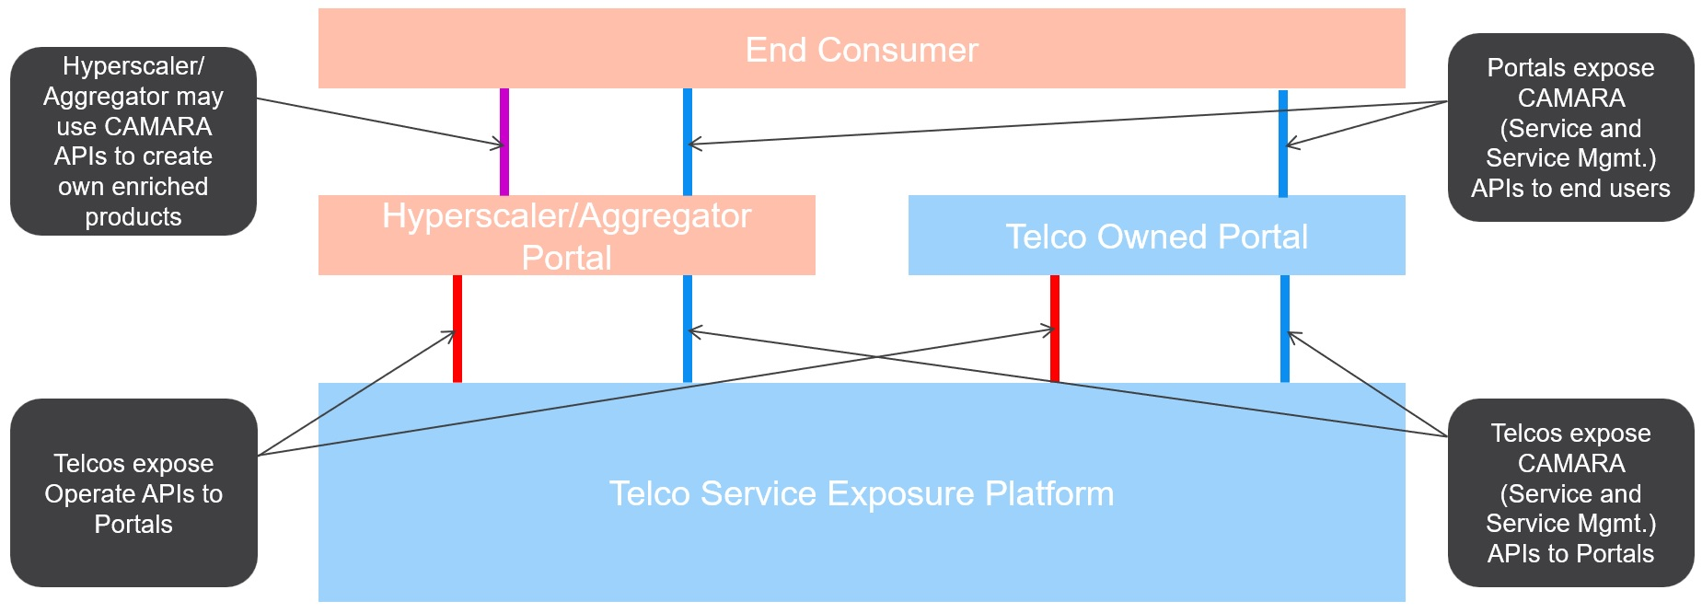
CAMARA – Scope / Collaboration with Open Gateway and TM Forum
Hyperscalers and aggregators have the possibility to create own enriched products based on the CAMARA APIs and expose that in addition to the CAMARA APIs.

Slide 11
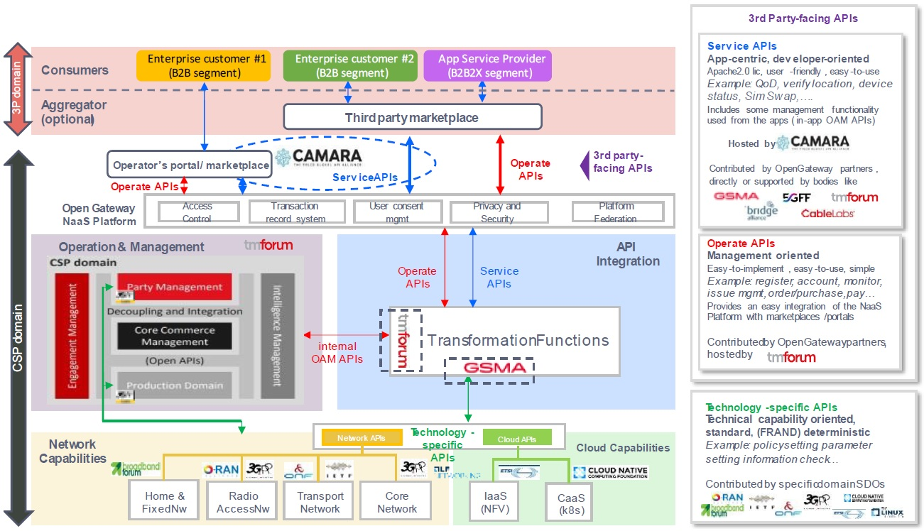
CAMARA – Scope / Collaboration with Open Gateway and TM Forum
CAMARA project defines
CAMARA APIs.
TMForum develops the Operate APIs.
Several SDOs cover the different technology domains that provide the telco capabilities.
More details can be found in the whitepaper “The Ecosystem for Open Gateway NaaS API Development” (jointly published by GSMA, CAMARA, Linux Foundation and TMForum) available here.

Slide 12




CAMARA – Scope / Collaboration with Open Gateway and TM Forum
API definition
Collaboration Agreement
Business templates for Northbound and E/W
Service API “standardization”
Standardization of distribution channels
Drive API Adoption (customers/developers and operators)
Developer Engagement
Playbooks
East-West Federation
Open API Ecosystem
Collaboration Agreement
Collaboration Agreement
Operate API definition
(catalogue and order management, on-/offboarding, billing)
Catalyst programs
Operate API standardization

Slide 13

CAMARA Scope
The scope of the CAMARA Project is:
Collect API requirements from GSMA Operator Platform Group and other sources
Define Service APIs and Service Management APIs
Create test plans / cases / tools from an API consumer perspective
Develop and test Service APIs and Service Management APIs
Create developer friendly documentation
The following deliverables are provided by the CAMARA Project:
Service API and Service Management API definitions and documentation
Optionally Service API and Service Management API code and
Test plans, cases and tools for the APIs all contained in deployment packages.
Project resources can be found in the GitHub repository: https://github.com/camaraproject.

Slide 14
CAMARA API Distribution Options
Single-Operator Relationship
Multi-Operator Relationship
End Consumer
Blue lines =
CAMARA APIs
Red lines =
Operate APIs
SEP= Service Exposure Platform
End Consumer
Portal 1
Aggregator
Portal 2
Portal 1
Aggregator
Portal 2
Telco SEP 1
Telco SEP 2
Telco SEP 1
Telco SEP 2
Operator Aggregation
Single-Operator “API Roaming”
End Consumer
End Consumer
Portal 1
Aggregator
Portal 2
Portal 1
Aggregator
Portal 2
Telco SEP 1
Telco SEP 2
Telco SEP 1
Telco SEP 2

Slide 15
What is different now in comparison to former API exposure trials?
Simplicity – Telco complexity is hidden behind simple, easy to use APIs
Demand driven - Listening to customer’s voice and demand
Availability – Open APIs with great support of many operators on many platforms
Alignment - With standardization bodies like TM Forum or ETSI-MEC
Sustainability – We have the CEOs behind (e.g. Open Gateway MoU, API Venture)
Telco maturity – Telcos are now more digital and cloud oriented
Privacy – Well defined

Slide 16





















CAMARA Where we started…
Launched at MWC Barcelona 2022
22 Launch Partners
Supported by GSMA and Linux Foundation
Simple idea to “standardize” developer facing APIs

Slide 17
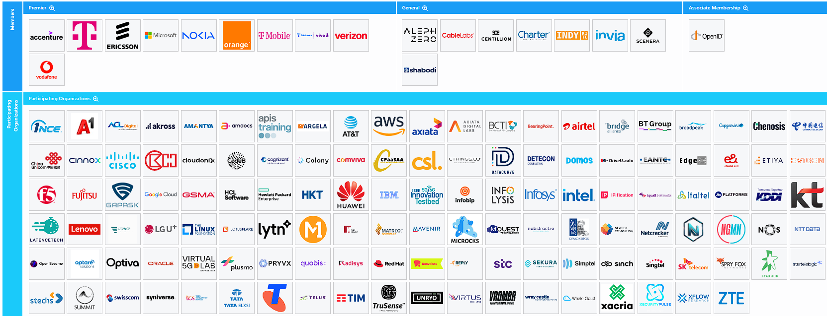
CAMARA … and where we are now
143 Named Partners
423 (+525*) companies participating in CAMARA
11 API family Sub Projects 21 Sandbox Projects 59 APIs 5 Working Groups
1255 (+2197*) people joined CAMARA
Development ”home” for GSMA Open Gateway
* Number in brackets indicates companies and people who are in contact but haven‘t joined

Slide 18
CAMARA Logos

Slide 19
Release Management Motivation and Benefits
A CAMARA meta-release combines a set of CAMARA API versions into a consistent release.
There will be two meta-releases per year (in spring and fall).
Network operator can plan their implementations and deployments in production.
API consumers can plan the integration in their platform and applications.
All API versions in a meta-release fulfill defined quality criteria and are compliant to current CAMARA guidelines like from CAMARA Commonalities and Identity and Consent Management.
CAMARA meta-releases ensure the
Availability of consistent API definitions (by use of guidelines, templates, and linting),
Quality of API definitions (by use of checklists, test definitions, and release management),
Stability of API definitions (clear criteria for stable versus initial API versions) and
Reliability of schedule and deliverables (with defined milestones and release candidates).
CAMARA meta-releases provide the foundation for API version management in production.

Slide 20
Release Management Release Cycle
Operator production deployments, certifications & channel integrations
of CAMARA Spring meta-release
(Operator/Vendor) Lab implementations & tests of release candidates (rc)
2 releases each year
Fall (in September)
Spring (in March)
Continuous and overlapping cycles
Update of CAMARA guidelines
Development and updates of API definitions in CAMARA
Lab implementations and production deployments at network operators
Tests of API release candidates
Within operator (lab) implementations
Based on CAMARA test definitions
Feedback in all phases
From(lab) implementations and deployments to CAMARA API definitions and guidelines
From API definition work to CAMARA guidelines
CAMARA API definitions
Alpha
RC
RC
Spring Meta-
release
CAMARA Guidelines
& Templates
Fall Meta-
release
RC
RC
CAMARA API definitions
Alpha
(Operator/Vendor)
Lab implementations & tests of release candidates (rc)
Operator production deployments, certifications & channel integrations
of CAMARA Fall meta-release
For details see: https://wiki.camaraproject.org/display/CAM/Meta-release+Process

Slide 21



















Stable and Initial APIs
Stable CAMARA APIs (v1.0.0)
Previous versions launched in at least one market¹
Updated initial CAMARA APIs (v0.y.z)
Previous versions launched in at least one market¹
0.6.0
0.6.0
1.0.0
1.0.0
0.2.0
0.3.0
0.1.0
Device Reachability Status (Device Status)
Device Roaming Status (Device Status)
Location Verification (Device Location)
Number Verification
Call Forwarding Signal
Carrier Billing
Carrier Billing Refund
1.0.0
0.11.0
0.2.1
0.11.0
1.0.0
1.0.0
0.2.0
0.3.0
One Time Passwort SMS (Number Verification)
QoS Profiles (Quality on Demand)
Quality on Demand
Sim Swap (Number Verification)
Simple Edge Discovery (Edge Cloud)
KYC¹ Match
KYC¹ Fill-In
Location Retrieval (Device Location)
New initial APIs (v0.y.z)
0.3.0
0.4.0
0.6.0
Application Profiles (Connectivity Insights)
Connectivity Insights
0.4.0
Device Roaming Status Subscriptions (Device Status)
0.6.0
0.3.0
Connectivity Insights Subscriptions
Device Reachability Status Subscriptions (Device Status)
Geofencing Subscriptions (Device Location)
0.4.0
0.1.0
0.1.0
0.1.1
SCAM Signal (GSMA)
?
0.1.0
Home Devices QoD
Population Density Data
QoD Provisioning (Quality On Demand)
Session Insights (Connectivity Insights)
SIM Swap Subscriptions (Number Verification)
1 Source: https://www.open-gateway.com/operators-map and https://wiki.camaraproject.org/display/CAM/Meta-release+Fall24
1 KYC = Know Your Customer

Slide 22
Stable and Initial APIs
Stable CAMARA APIs (v1.0.0)
Previous versions launched in at least one market¹
Updated initial CAMARA APIs (v0.y.z)
Previous versions launched in at least one market¹
Device Reachability Status (Device Status)
Device Roaming Status (Device Status)
Location Verification (Device Location)
Number Verification
Call Forwarding Signal
Carrier Billing
Carrier Billing Refund
One Time Passwort SMS (Number Verification)
QoS Profiles (Quality on Demand)
Quality on Demand
Sim Swap (Number Verification)
Simple Edge Discovery (Edge Cloud)
KYC¹ Match
KYC¹ Fill-In
Location Retrieval (Device Location)
New initial APIs (v0.y.z)
Application Profiles (Connectivity Insights)
Connectivity Insights
Connectivity Insights Subscriptions
Device Reachability Status Subscriptions (Device Status)
Device Roaming Status Subscriptions (Device Status)
Geofencing Subscriptions (Device Location)
Home Devices QoD
Population Density Data
QoD Provisioning (Quality On Demand)
SCAM Signal (GSMA)
Session Insights (Connectivity Insights)
SIM Swap Subscriptions (Number Verification)
1 Source: https://www.open-gateway.com/operators-map and https://wiki.camaraproject.org/display/CAM/Meta-release+Fall24
1 KYC = Know Your Customer

Slide 23



















Upcoming APIs
Upcoming APIs
Work in progress or newly started
Application Endpoint Discovery
(Edge Cloud)
Blockchain Public Address
Capability And Runtime Restrictions
Click To Dial
Connected Network Type (Device Status)
Connected Network Type Subscriptions (Device Status)
Customer Insights
Device Data Volume (Device Status)
Device Data Volume Subscriptions (Device Status)
Device Identifier
Device Quality Indicator
(Device Status)
Device Swap
Device Visit Location
Edge Application Management
(Edge Cloud)
Energy Footprint Notification
KYC¹ Age Verification
KYC¹ Tenure
Most Frequent Location
Network Access Management
(Home Devices QoD)
Network Slice Booking
Number Recycling (KYC¹)
QoS Booking (Quality on Demand)
Region Device Count
Site to
Cloud VPN
SMS
SMS Delivery Notification Subscription
Subscription Status
(KYC¹)
Traffic Influence
(Edge Cloud)
Verified Caller
WebRTC Call Handling
WebRTC Event Subscription
WebRTC Registration
1 KYC = Know Your Customer

Slide 24
Current CAMARA Sub Projects / Sandbox Projects
Blockchain Public Address
Call Forwarding Signal
Capabilities And Runtime Restrictions
Carrier Billing
CheckOut
Click to Dial
Connectivity Insights
Identify a client device trying to access network services
Anonymised Subscriber ID
Manage a blockchain public address associated to a phone number
Determine if a “call forwarding” service is enabled
Provide capabilitites and runtime restrictions
Purchase, pay, and follow up on fulfilment of products
Establish web-based communication by clicking an object
Alerts the consumers if and when the QoS threshold has breached
Customer Insights
Dedicated Networks
Device Identifier
Device
Location
Device Status
Device Swap
Provides an index or scoring related to the user's credit profile
Requests / modifies / deletes a (logical) dedicated network
Check the identity of the subscribers’ device
Check the location of a device
Check the network connection and roaming status of a device
Check if the MSISDN has had a change of device in the last 30 days
Edge Cloud
Energy Footprint Notification
High Throughput Elastic Netw.
Home Devices QoD
Know Your Customer
Location Insights
Provide and manage network and compute resources for an application
Provide information about the E2E energy consumption and carbon footprint
Calculates load-balancing paths with given duration, data and bandwidth
Request prioritization of traffic on a specific device on the home network
Allows service providers to validate user information with operators
Give insights to the home area and latest location of a device

Slide 25
Current CAMARA Sub Projects / Sandbox Projects
CAMARA Working Groups
Model as a Service
Network Slice Booking
API Backlog
Common-
alities
Identity and Consent Management
Build, deploy, monitor, and invoke LLM
Reserve, dynamically provision, query, dynamically delete a slice
Maintains the API Backlog for CAMARA
Guidelines and assets mandatory for all CAMARA Sub Projects
Provides solutions to capture, store and manage user consent
Number Verification
Population Density Data
Quality on Demand
Marketing / Outreach
Release Management
Allows users to
verify the phone number of the connected device
Get dynamic population density data in a specific area for a future date & time
Allows users to set mobile connection quality
and get notifications
Plans and performs marketing activities for CAMARA
Guidelines and assets for Release Management in CAMARA
Region Device Count
Short Message Service
Site to Cloud VPN
Verified Caller
WebRTC
Query the number of active devices in the specified area
Send SMS to the destination address(es)
Create and configure site to cloud network service by one click
Show certified information on the phone before a call is answered
Add real-time communication capabilities to applications

Slide 26


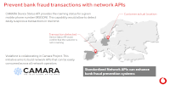
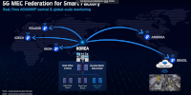
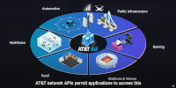

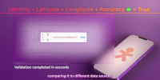







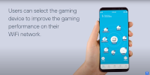





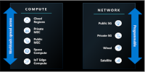
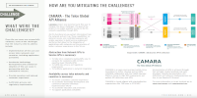
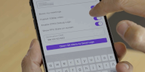

CAMARA / Open Gateway API Showcases
https://camaraproject.org/resources/

Slide 27
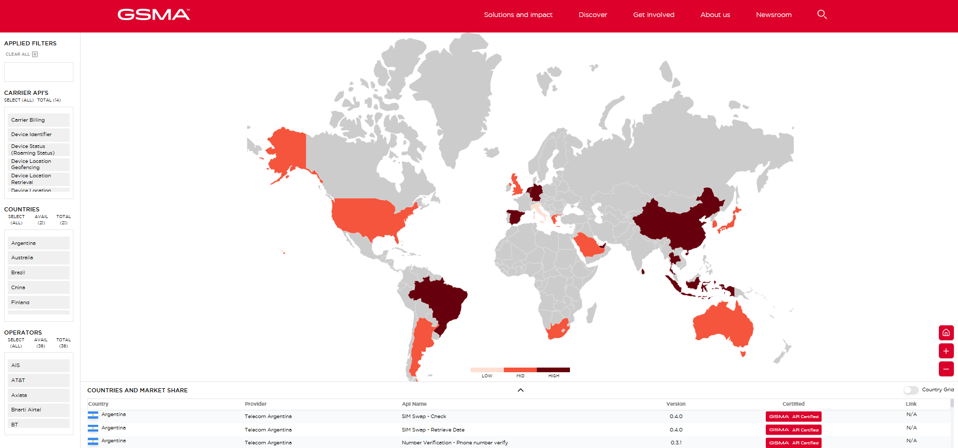
CAMARA / Open Gateway API public launch status
https://open-gateway.gsma.com/

Slide 28
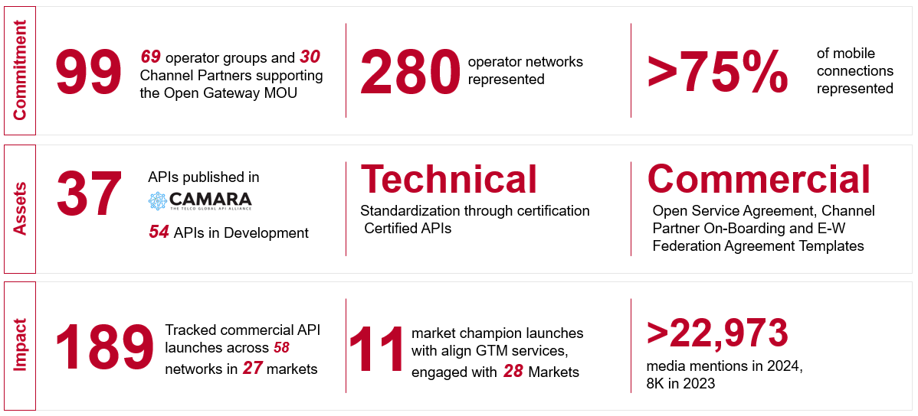
CAMARA / Open Gateway API public launch status

Slide 29
5G network capabilities Introduction
Telco network capabilities are functions partly available already in 4G but new and much more powerful in the 5G network. These functions enable to get information out of the network but also to configure the network.
The on-demand, secure and controlled exposure of these capabilities pave the way for transforming operator networks into service enablement platforms, facilitating the application-to-network integration, which will be key to deliver enhanced and service-tailored customer experience in the 5G era.

Slide 30






5G network capabilities Introduction
Reachability and Location of UEs
Identify (last known) location of drone
# of UEs in geographic region
Traffic jam or Corona warning
# of UEs in slice, network congestion
Adapt resolution for video transmission
Quality on Demand / Traffic influence
Enable augmented reality
Wake up UEs
Support low energy IoT devices
Block UEs in geographic region
Crisis management

Slide 31





Potential Business Use Cases
Authentication and Fraud Prevention
Location Services
Communication Quality
Device Information
Computing Services
Network APIs offer the opportunity
For customers to optimize their use cases and applications
For operators to monetize their invest in 5G infrastructure
It’s a win-win!
Secure Auth
Fraud Prevention
Location Verification
Location Retrieval
Location Geofencing
Safeguarding of Transactions
Remote Control
AR/VR/XR
Gaming
Proactive User Information
Edge Application hosting
Latency optimization
Number Verify, Sim Swap, etc.
Location APIs
Quality on Demand
Device Data Volume
Simple Edge Discovery

Slide 32
Benefit for developers to use CAMARA APIs
1
Reduces friction for developers to access network information across telcos globally.
Additional revenue on existing assets, leveraging SDN and NFV capabilities
2
Increases usage and value of telco networks by providing easy access to network capabilities.
3
Enables developers to create new applications or improve existing ones with access to these capabilities.

Slide 33
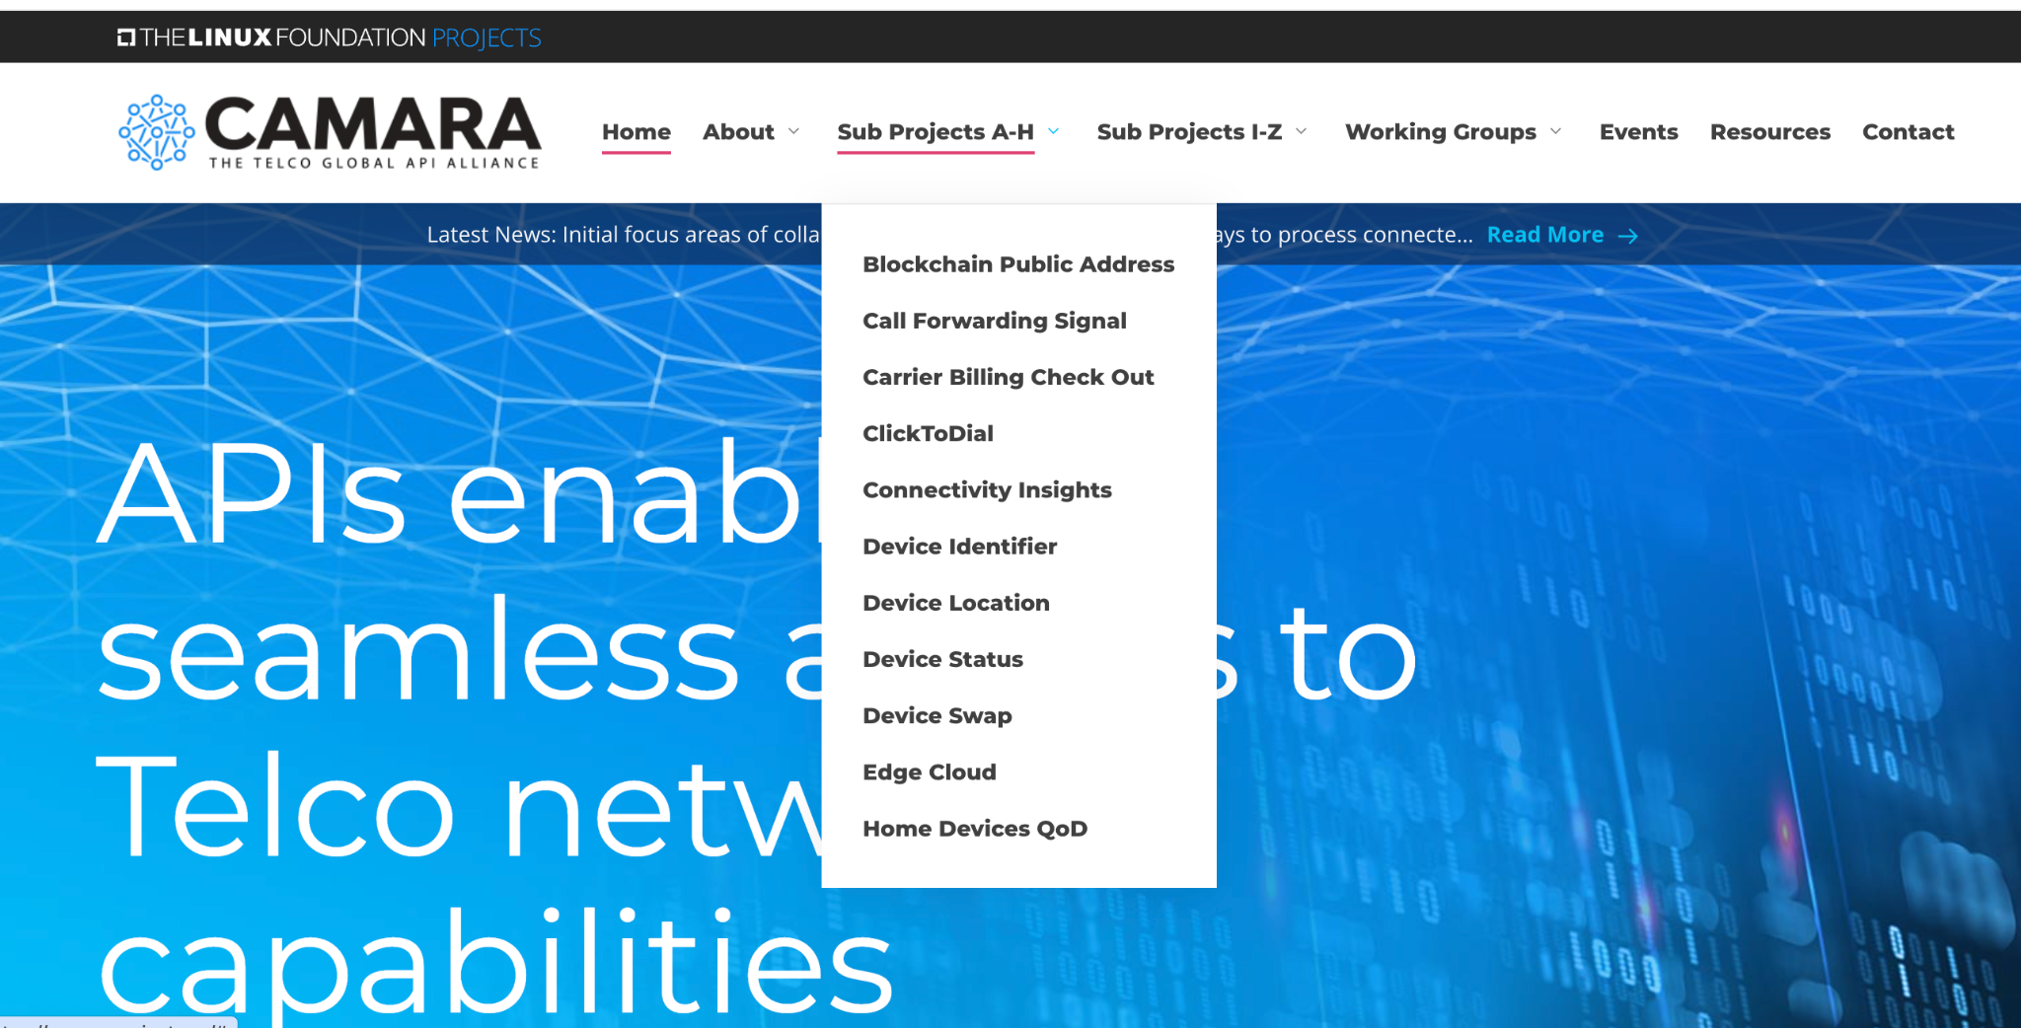
Developers Getting Started with CAMARA APIs

Slide 34
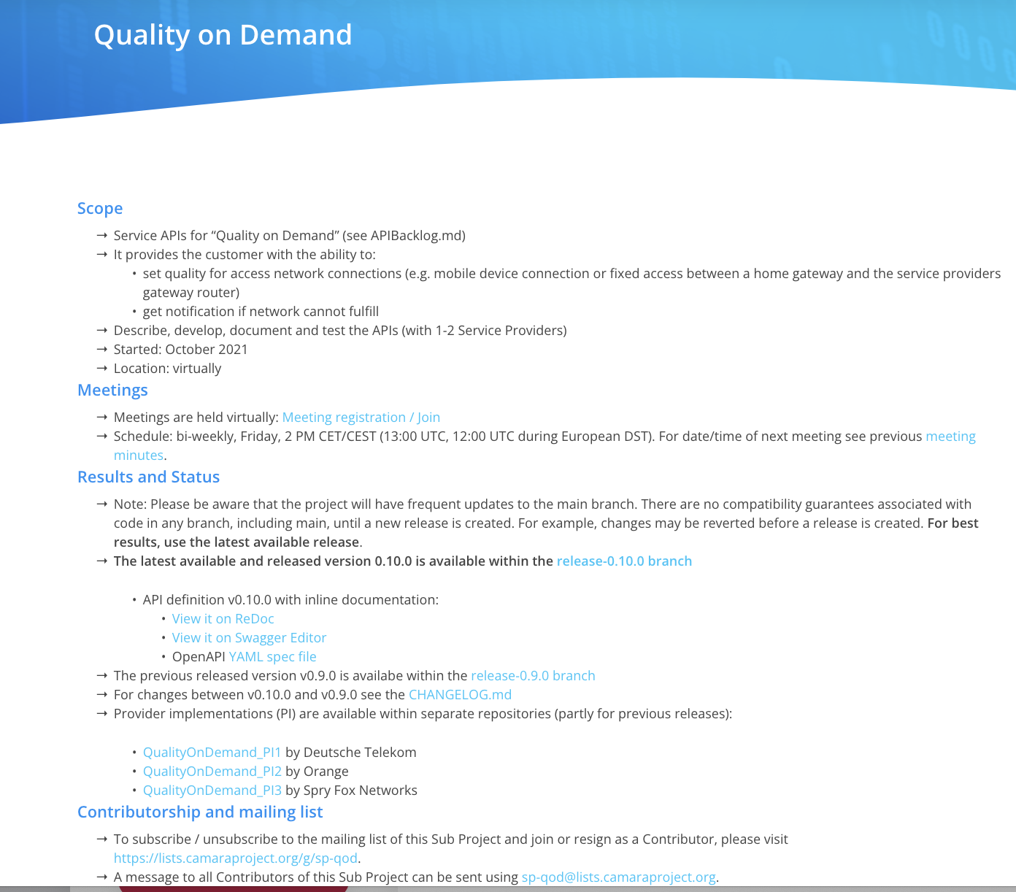
Developers Getting Started with CAMARA APIs

Slide 35
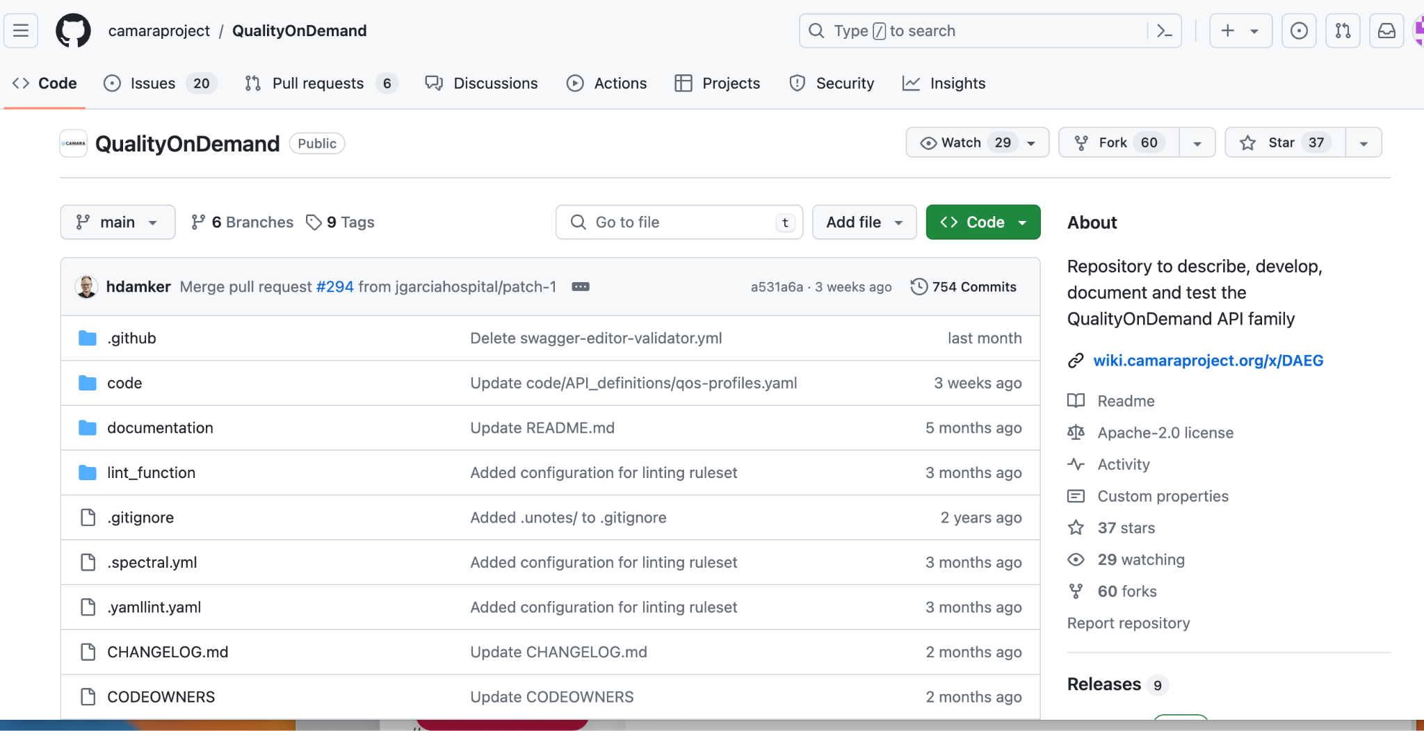
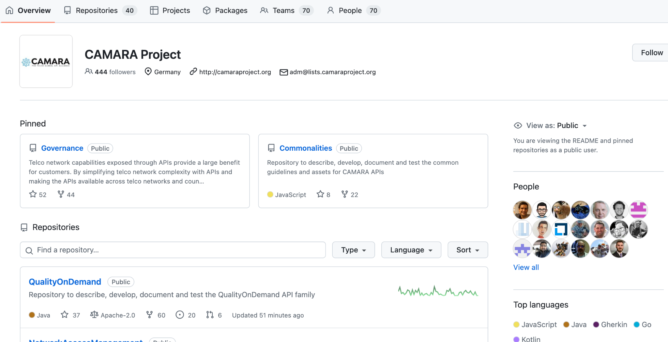
Developers Getting Started with CAMARA APIs

Slide 36
Benefit for developers to work in CAMARA
As a typical Open Source Project CAMARA is driven by contribution!
People who contribute define priorities and drive the direction.
Working in CAMARA on API definitions, API documentations and API code (transformation functions) enables to
Bring in own demand and contribute a solution
Influence the definition of new APIs and API versions
Ensure that own requirements are considered
Provide code which can be used globally
Learn about CAMARA, Open Gateway and the Network API ecosystem
Get deep knowledge about the APIs
Become maintainer and TSC member to influence technical decisions in CAMARA

Slide 37
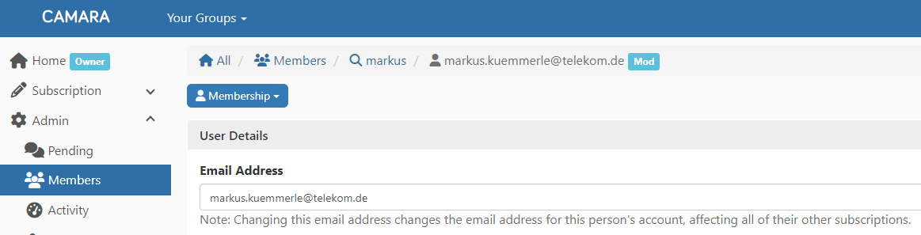
Joining CAMARA as Developer
To join the CAMARA mailing list send an (empy) email to all+subscribe@lists.camaraproject.org.
The CAMARA GitHub https://github.com/camaraproject can be accessed without any prerequisite. To create issues and start contributing to CAMARA you need a free GitHub account.

Slide 38
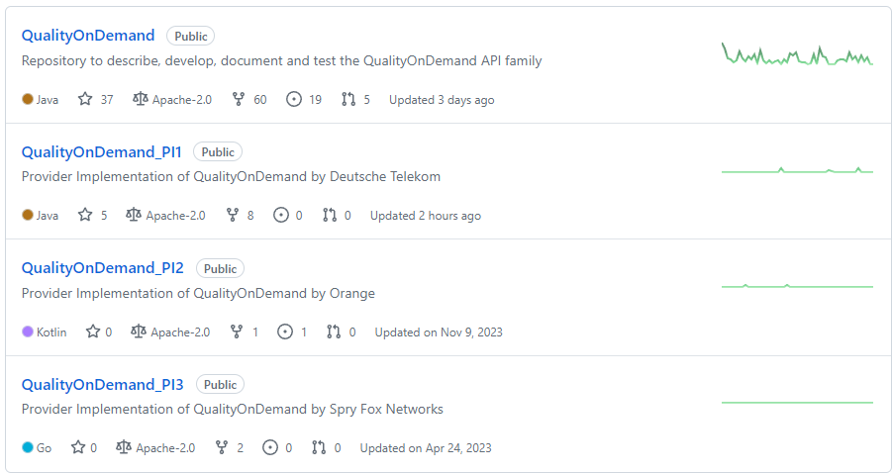
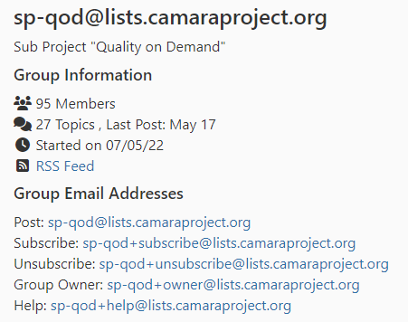
Joining CAMARA as Developer
Each API family / working group in CAMARA is organized as a separate Sub Project with (example QoD):
A dedicated lead repository (containing API definition and API documentation)
0…n provider implementation repositories (containing API code)
A dedicated mailing list

Slide 39
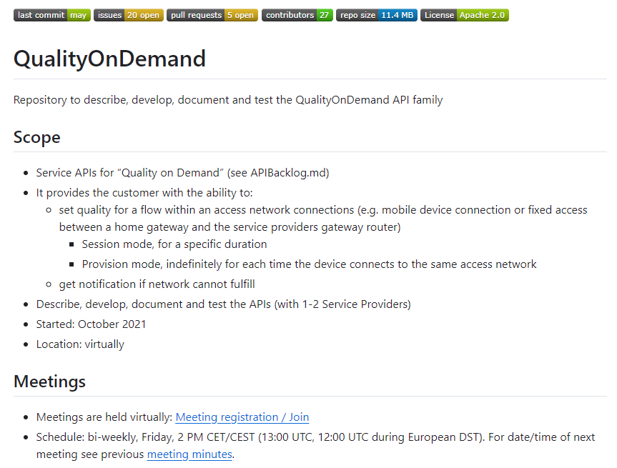
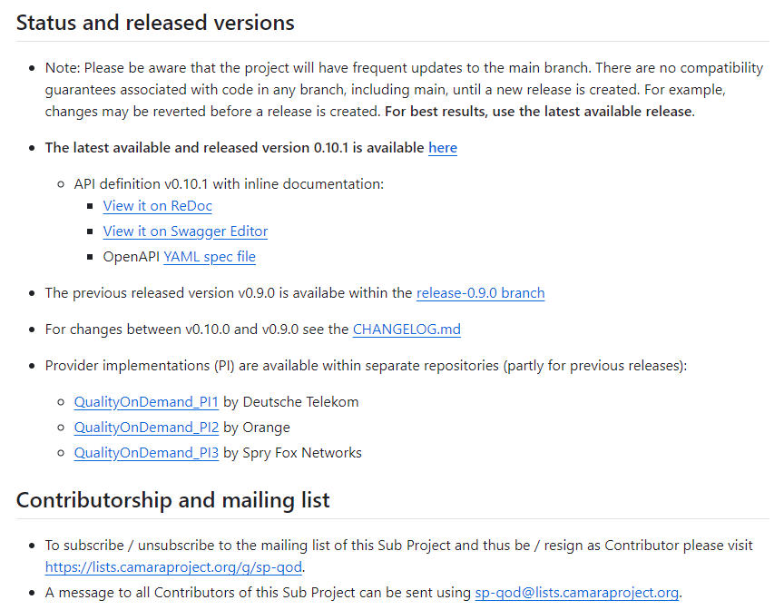
Joining a Sub Project as Developer
To join a Sub Project please have a look into its Readme.md (example Quality on Demand):

Slide 40
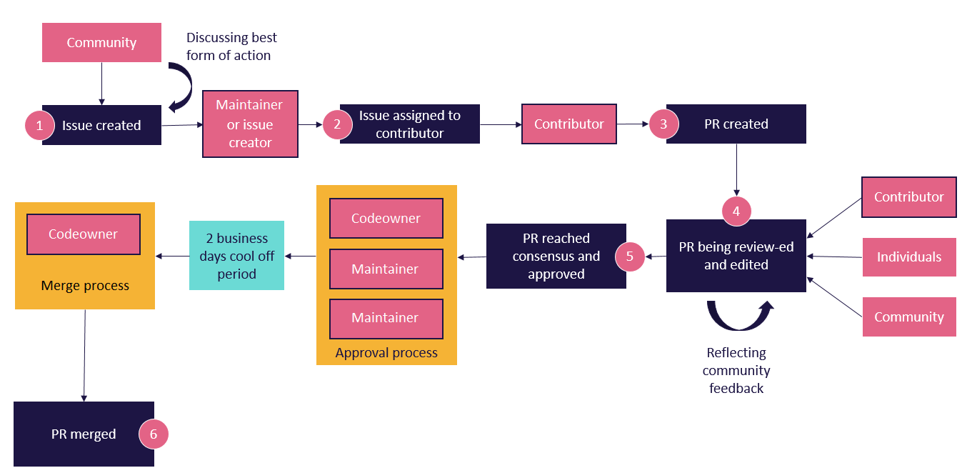
Contributing to CAMARA
In the Project the “Fork and pull model” is used. Changes and contributions to CAMARA shall follow this process:
thttps://github.com/camaraproject/Governance/blob/main/ProjectStructureAndRoles.md

Slide 41

Benefit for operators to implement CAMARA APIs in their networks
Operators have made high investments in
Spectrum licences
Infrastructure (cell towers, fibre)
Operators haven‘t been successful in
Increasing prices for connectivity contracts
CAMARA APIs open a possibility
To monetize the high investments
To improve customer experience
For market positioning

Slide 42


What have operators to do to implement Network APIs?
Develop APIs and products based on the network capabilitites
Implement an exposure infrastructure
Define commercial products
Sell it

Slide 43






What have operators to do to implement Network APIs?
Customer
Possible API workflows
Catalog published from SEP to portals
Customer onboarding to SEP
Customer orders API, SEP sends credentials to access API
If necessary SEP requests user consent for API. Capacity management is done. Customer uses API. SEP performs metering and rating.
SEP initates billing for wholesale and retail
Customer offboarding
Wholesale
(Aggregators, Hyperscaler, SIs, ISVs)
Telco Portal
(Enterprise Customers)
Service Exposure Platform (SEP)
Internal API-Gateways
Network / Backend
Mobile Network Capabilities
Fixed Line Network Capabilities
Telco IT Capabilities
Cloud Capabilities
Service API
IT API
Operate API

Slide 44
Benefit for operators to work in CAMARA
Networking and Partnerships
Access to a growing global network of industry leaders
Technological Advancements
Knowledge Exchange
Shared Resources
Collaborative projects often lead to cost savings through shared resources and reduced duplication of efforts
Benefit from the collective research efforts
Collaborative Innovation
Industry Collaboration
Standardization: contribute to development of industry standards, ensuring interoperability and consistency across networks and services
Bring in your requirements!

Slide 45
Benefit for operators to work in CAMARA
Why Join CAMARA as a sponsor /member?
Seat on the Governing Board to influence CAMARA strategy
Elevate your Brand
Signal Support & Commitment to open API development
Discounts on Linux Foundation events & programs
Help ensure the Project continues to provide needed governance & infrastructure
Platform to showcase thought leadership

Slide 46
Operators Getting Started with CAMARA
Individuals and organizations from API customers (e.g. enterprises and startups), aggregators, cloud operators, telco operators, network equipment vendors, system integrators, and software vendors are welcome to join CAMARA.
For organizations:
If you are interested to show your logo on the CAMARA website as “Participating Organization” send a .SVG version of it to adm@lists.camaraproject.org. Participation is free, without any fees or obligations.
If you would like to become a CAMARA sponsor please don’t hesitate to use the enrollment link. The cost is depending on the kind of membership and the number of employees.
Associate Members of The Linux Foundation can also join as "Associating organization" for free, without any fees or obligations.

Slide 47
CAMARA Where are we going next…
1
Additional APIs and roadmap sync across CSPs, Aggregators and Hyperscalers
2
API lifecycle management consistency,
Documentation of API versioning and availability globally
3
Drive API Adoption (customers/developers and operators)

Slide 48

CAMARA Contacts
Individuals and organizations from API customers (e.g. enterprises and startups), aggregators, cloud operators, telco operators, network equipment vendors, system integrators, and software vendors are welcome to join CAMARA.
To access CAMARA technical resources like API definitions, API specifications or API code just visit the CAMARA GitHub. All resources are reachable without any prerequisite. To create issues and start contributing to CAMARA you need a free GitHub account without any further prerequisite. This participation is free, without any fees or obligation to work.
If you are interested to be included in the CAMARA communication, please subscribe to all+subscribe@lists.camaraproject.org. You may unsubscribe from CAMARA and these communications at any time. Participation is free.
If you are interested to show your logo on the CAMARA website as “Participating Organization” you can send it to adm@lists.camaraproject.org. Participation is also free.
If you would like to join as CAMARA sponsor or associating organization, please don’t hesitate to use the enrollment link https://enrollment.lfx.linuxfoundation.org/?project=camarafund. Cost is depending on the kind of membership and the number of employees.

Slide 49


